Slide 1
Psalm 110 3 Slides
Hebrews 6:19 - 7:28
(English Standard Version)

Slide 2
110 A Psalm of David.
¹ The Lord says to my Lord: “Sit at my right hand, until I make your enemies your footstool.”

Slide 3
² The Lord sends forth from Zion your mighty scepter. Rule in the midst of your enemies!
³ Your people will offer themselves freely on the day of your power, in holy garments; from the womb of the morning, the dew of your youth will be yours.
⁴ The Lord has sworn and will not change his mind, “You are a priest forever after the order of Melchizedek.”

Slide 4
⁵ The Lord is at your right hand; he will shatter kings on the day of his wrath.
⁶ He will execute judgment among the nations, filling them with corpses; he will shatter chiefs over the wide earth.
⁷ He will drink from the brook by the way; therefore he will lift up his head.

Slide 5
Psalm 110
Hebrews 6:19 - 7:28 6 Slides
(English Standard Version)

Slide 6
¹⁹ We have this as a sure and steadfast anchor of the soul, a hope that enters into the inner place behind the curtain, ²⁰ where Jesus has gone as a forerunner on our behalf, having become a high priest forever after the order of Melchizedek.
7 For this Melchizedek, king of Salem, priest of the Most High God, met Abraham returning from the slaughter of the kings and blessed him, ² and to him Abraham apportioned a tenth part of everything. He is first, by translation of his name, king of righteousness, and then he is also king of Salem, that is, king of peace. ³ He is without father or mother or genealogy, having neither beginning of days nor end of life, but resembling the Son of God he continues a priest forever.

Slide 7
⁴ See how great this man was to whom Abraham the patriarch gave a tenth of the spoils! ⁵ And those descendants of Levi who receive the priestly office have a commandment in the law to take tithes from the people, that is, from their brothers, though these also are descended from Abraham. ⁶ But this man who does not have his descent from them received tithes from Abraham and blessed him who had the promises. ⁷ It is beyond dispute that the inferior is blessed by the superior. ⁸ In the one case tithes are received by mortal men, but in the other case, by one of whom it is testified that he lives. ⁹ One might even say that Levi himself, who receives tithes, paid tithes through Abraham, ¹⁰ for he was still in the loins of his ancestor when Melchizedek met him.

Slide 8
¹¹ Now if perfection had been attainable through the Levitical priesthood (for under it the people received the law), what further need would there have been for another priest to arise after the order of Melchizedek, rather than one named after the order of Aaron? ¹² For when there is a change in the priesthood, there is necessarily a change in the law as well. ¹³ For the one of whom these things are spoken belonged to another tribe, from which no one has ever served at the altar. ¹⁴ For it is evident that our Lord was descended from Judah, and in connection with that tribe Moses said nothing about priests.
¹⁵ This becomes even more evident when another priest arises in the likeness of Melchizedek, ¹⁶ who has become a priest, not on the basis of a legal requirement concerning bodily descent, but by the power of an indestructible life.

Slide 9
¹⁷ For it is witnessed of him,
“You are a priest forever,
after the order of Melchizedek.”
¹⁸ For on the one hand, a former commandment is set aside because of its weakness and uselessness ¹⁹ (for the law made nothing perfect); but on the other hand, a better hope is introduced, through which we draw near to God.

Slide 10
²⁰ And it was not without an oath. For those who formerly became priests were made such without an oath, ²¹ but this one was made a priest with an oath by the one who said to him:
“The Lord has sworn
and will not change his mind,
‘You are a priest forever.’ ”
²² This makes Jesus the guarantor of a better covenant.

Slide 11
²³ The former priests were many in number, because they were prevented by death from continuing in office, ²⁴ but he holds his priesthood permanently, because he continues forever. ²⁵ Consequently, he is able to save to the uttermost those who draw near to God through him, since he always lives to make intercession for them.
²⁶ For it was indeed fitting that we should have such a high priest, holy, innocent, unstained, separated from sinners, and exalted above the heavens. ²⁷ He has no need, like those high priests, to offer sacrifices daily, first for his own sins and then for those of the people, since he did this once for all when he offered up himself. ²⁸ For the law appoints men in their weakness as high priests, but the word of the oath, which came later than the law, appoints a Son who has been made perfect forever.

Slide 12
Jesus Christ: A new high priest (of the order of Melchizedek)

Slide 13
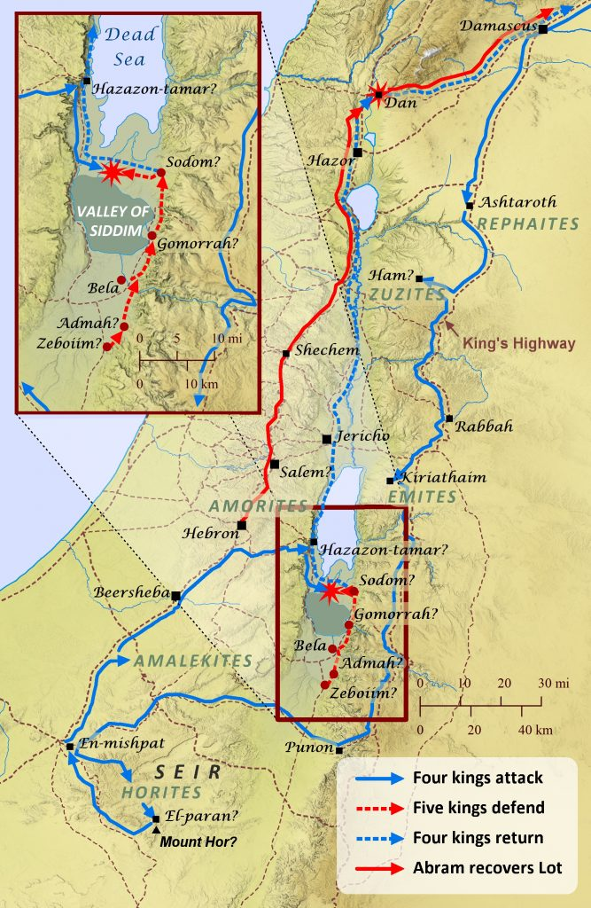

Slide 14
Jesus Christ: A new high priest (of the order of Melchizedek)
Genesis 14:17–24 (ESV)
¹⁷ …. the king of Sodom went out to meet him at the Valley of Shaveh (that is, the King’s Valley). ¹⁸ And Melchizedek king of Salem brought out bread and wine. (He was priest of God Most High.) ¹⁹ And he blessed him and said,
“Blessed be Abram by God Most High,
Possessor of heaven and earth;
²⁰ and blessed be God Most High,
who has delivered your enemies into your hand!”
And Abram gave him a tenth of everything.
Melchizedek:
King of Salem (Jerusalem). (King of Peace).
Priest of God Most High
Brings bread & wine to the faithful (an image of Christ)
High Priest:
Intermediary between sinful man & Holy God;
Make sacrifices to atone for the sins of the people;
Had to sacrifice for his own sins.

Slide 15
Jesus Christ: A new high priest (of the order of Melchizedek)
1. Jesus is the Forever Priest
The Son of God continues as priest forever.
2. The Greatness of Jesus
Jesus is greater than the Levite priests. He lives eternally.
3. Perfection
The Old Covenant (Law) / old priesthood failed.
Under New Management. A new perfect High Priest for a new covenant.
4. Legality Vs. Divine Power
The Law said Priesthood had to come from tribe of Levi.
Jesus comes from Tribe of Judah. But has the power of an indestructible life. Priest forever.
5. The main point: A Better Hope
Through Jesus, we draw near to God
The Law made nothing perfect. The Godly, love it, but it remains an unscalable mountain.
God sets aside the old way of doing things (Old Covenant). We draw near to God.
6. Permanency by an Oath of God
Jesus will ALWAYS be, the ONLY way to God.
7. Permanence = Perfecting Opportunity
Jesus is here to stay, so will get the job done.
²⁵ … he is able to save to the uttermost those who draw near to God through him, since he always lives to make intercession for them.
8. Perfection of the Devine Son
Jesus is perfect and sinless.
His death on the cross – The perfect, once and for all sacrifice. Never needs repeating.
The only way to draw near to God, is through Jesus.
Because He is perfect, He can save us to the uttermost. Perfecting us – preparing for eternity

